Slide 1







TrioSim: a Lightweight Simulator for Large-Scale DNN Workloads on Multi-GPU Systems
Ying Li¹, Yuhui Bao^{2,3}, Gongyu Wang³, Xinxin Mei⁴, Pranav Vaid^{3,5}, Anandaroop Ghosh³,
Adwait Jog⁶, Darius Bunandar³, Ajay Joshi^{3,7} and Yifan Sun¹
¹ William & Mary ² Northeastern University ³ Lightmatter ⁴ Jefferson Lab
⁵ Stanford University ⁶ University of Virginia ⁷ Boston University

Slide 2

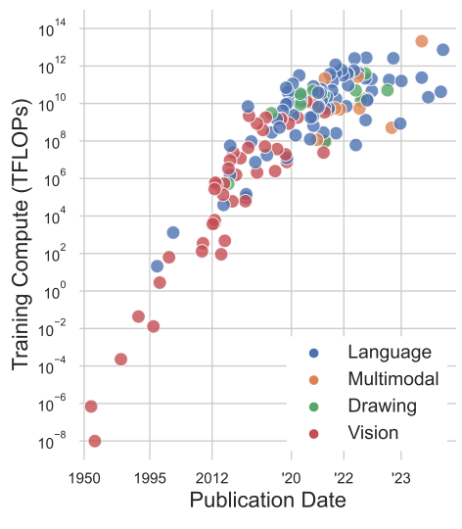
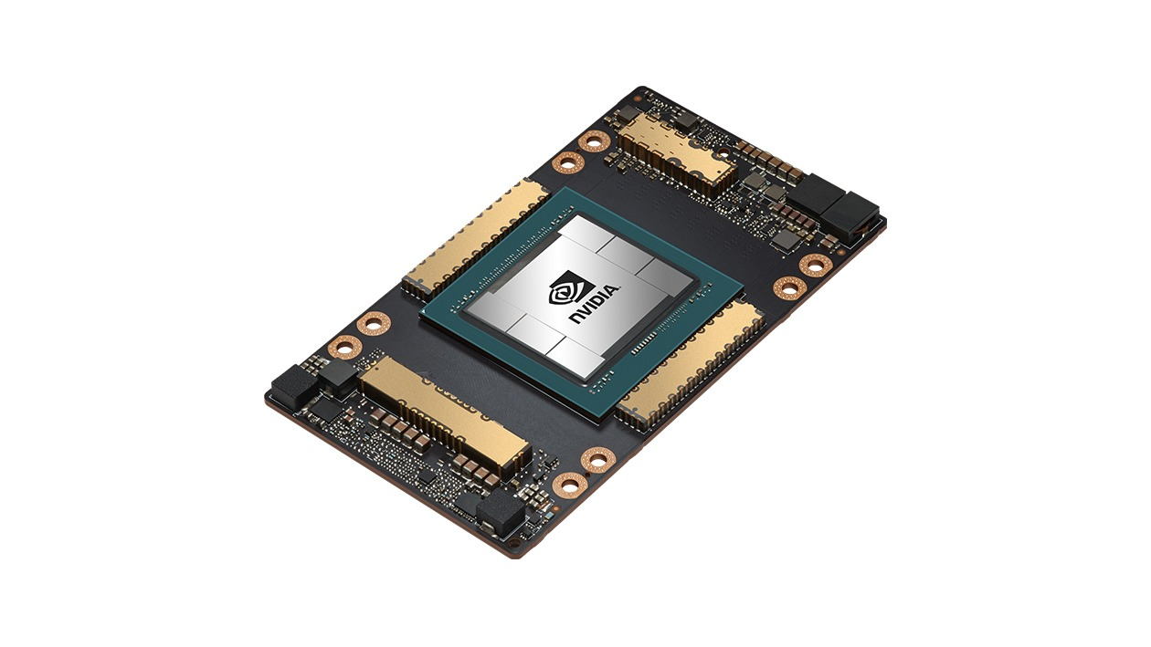

Motivation
GPT-4 network
25000 A100 GPUs
Large Workload
90-100 days

Slide 3
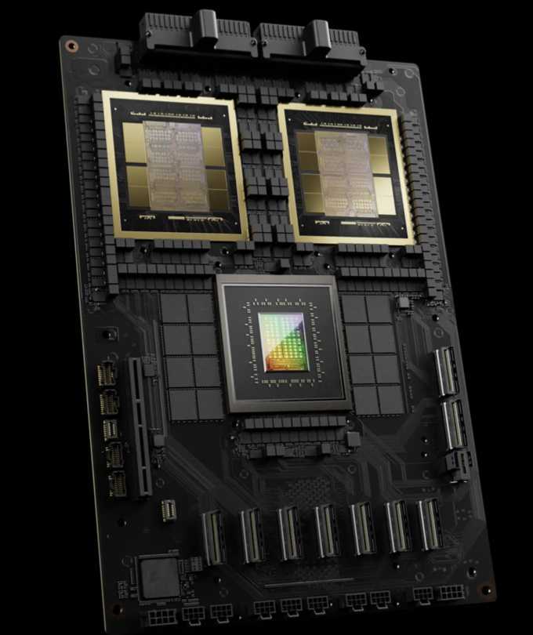
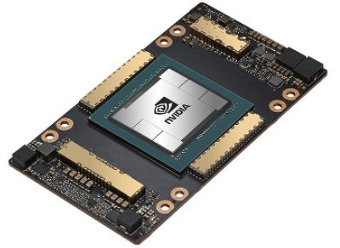
Motivation
= 5 A100 GPUs
Large Workload
GB200. Two GPUs, one CPU.

Slide 4
Large Workload
GB200. Two GPUs, one CPU.
Large Compute, Large Memory, Large Communication

Slide 5
Large Workload
GB200. Two GPUs, one CPU.
Large Compute, Large Memory, Large Communication
Simulators

Slide 6



GPU Simulators
NVIDIA. (n.d.). GPU-Powered Simulation & Modeling. Retrieved from https://www.nvidia.com/en-us/high-performance-computing/simulation-and-modeling/"

Slide 7
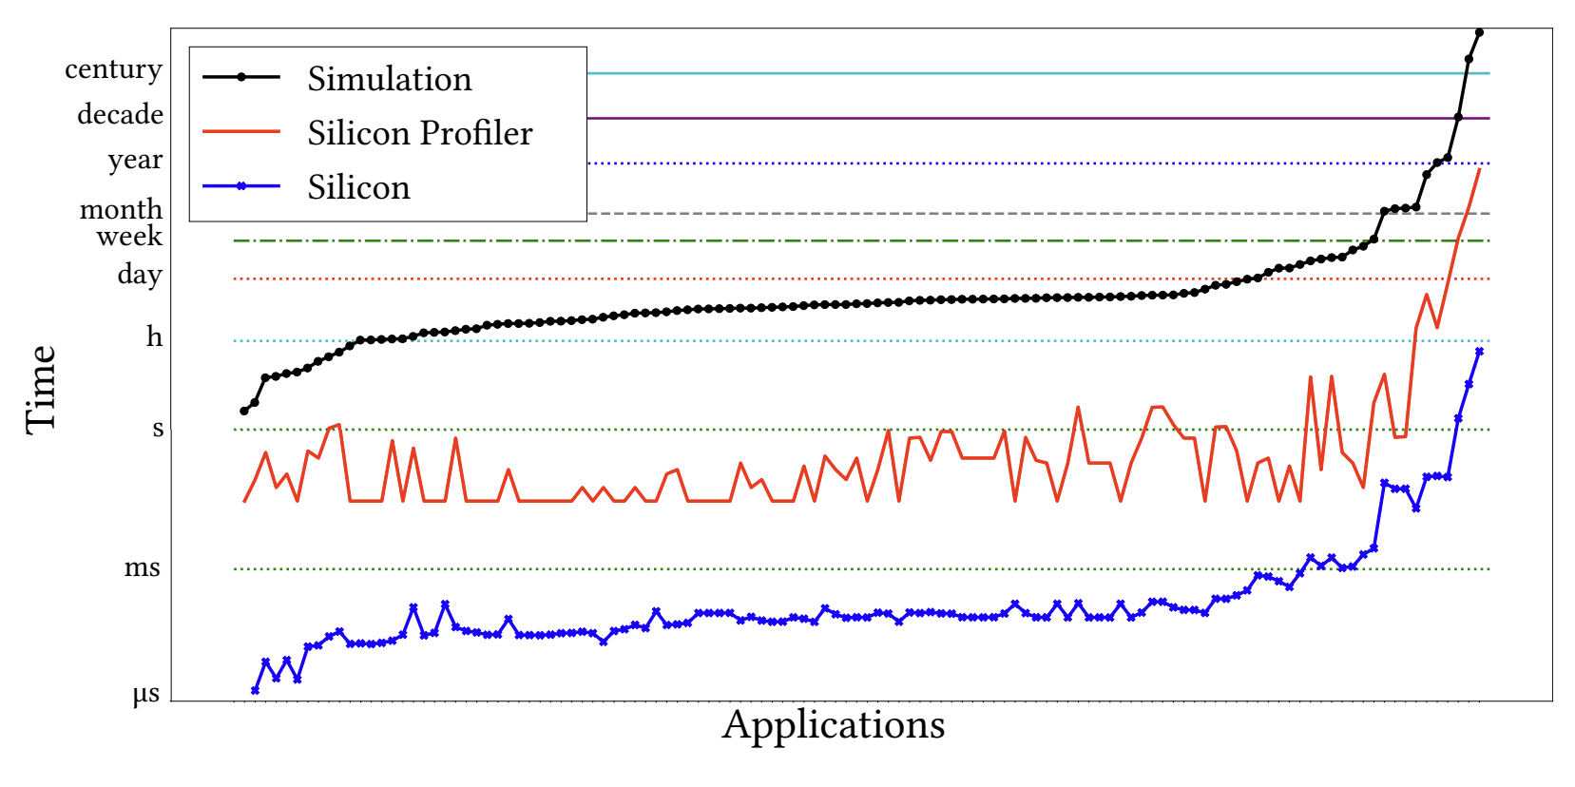
Simulation Performance
10⁶X - 10⁸X Slower
1 Second execution
10 days – 2years
Simulation details
Gate-level
Cycle-level
Instruction-level
Simulation
Simulation
GPU time
GPU time
Avalos Baddouh, Cesar, Mahmoud Khairy, Roland N. Green, Mathias Payer, and Timothy G. Rogers. "Principal kernel analysis: A tractable methodology to simulate scaled gpu workloads." In MICRO-54: 54th Annual IEEE/ACM International Symposium on Microarchitecture, pp. 724-737. 2021.

Slide 8
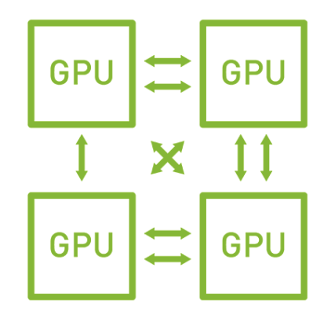
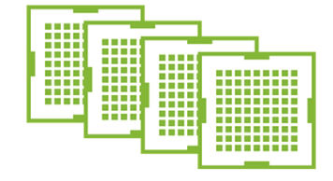

Solutions
Simulate at a higher level of abstraction.
Operator-level traces from single GPU to simulate multiple GPUs execution.
TrioSim: Simulator for Large-Scale DNN Workloads on Multi-GPU Systems
https://www.nvidia.com/en-us/design-visualization/solutions/multi-virtual-gpus/

Slide 9
TrioSim

Slide 10
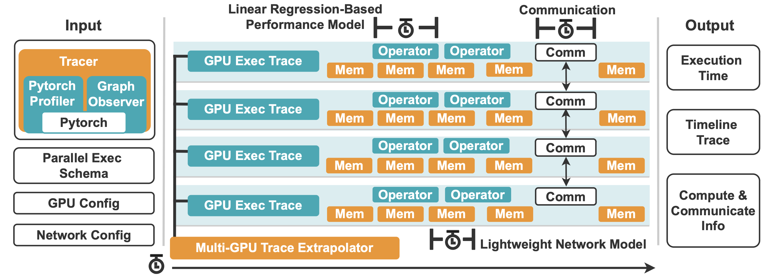
TrioSim

Slide 11
TrioSim

Slide 12
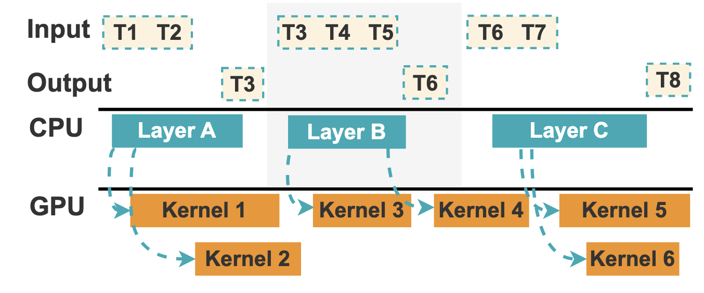
TrioSim

Slide 13
TrioSim

Slide 14
TrioSim
Trace Extrapolator
Training parallelism
Network structure
Communication pattern

Slide 15
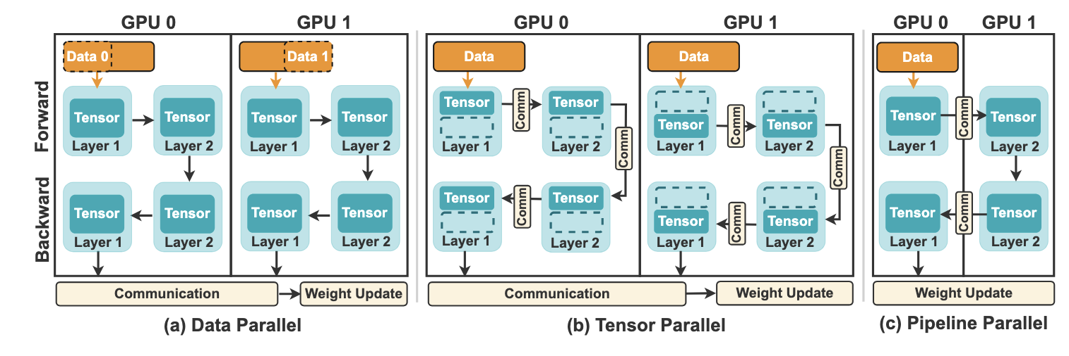
TrioSim
Trace Extrapolator
Training parallelism
Network structure
Communication pattern

Slide 16
TrioSim
Trace Extrapolator
Training parallelism
Network structure
Communication pattern

Slide 17
TrioSim
Trace Extrapolator
Training parallelism
Network structure
Communication pattern

Slide 18
TrioSim
Trace Extrapolator
Training parallelism
Network structure
Communication pattern

Slide 19
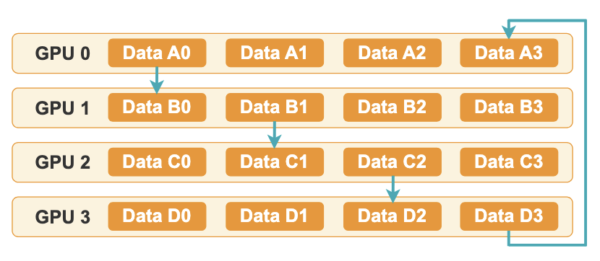
TrioSim
Trace Extrapolator
Training parallelism
Network structure
Communication pattern

Slide 20
TrioSim

Slide 21
TrioSim

Slide 22
TrioSim

Slide 23
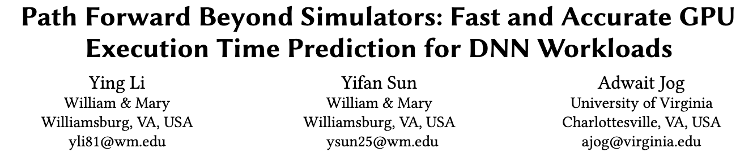
MICRO 2023

Slide 24
MICRO 2023
Layer or kernel execution times are generally linearly correlated to their Floating Point Operations.

Slide 25
TrioSim

Slide 26
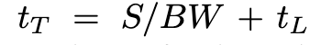
TrioSim
GPU
1. Bandwidth 2. Latency
Total Transfer Time = Data Size/ Link Bandwidth + Link Latency
GPU
GPU
GPU

Slide 27
TrioSim

Slide 28
TrioSim

Slide 29
TrioSim

Slide 30
Experiment
Hardware.
P1: 2 NVIDIA A40 GPUs, connected with PCIe.
P2: 4 NVIDIA A100 GPUs, connected with NVLinks.
P3: 8 NVIDIA H100 GPUs, connected with NVLinks.
Software.
CUDA 12.1
Torch 2.1.0+cu121
Torchvision 0.16.0+cu121
Torchaudio 2.1.0+cu121
Workloads.
Image Classification: DenseNet, ResNet, VGG.
NLP: GPT-2, BERT-Base-Uncased, T5-Small, FLAN-T5-Small, and Llama.
Parallelism strategy.
Data parallelism, tensor parallelism, and pipeline parallelism

Slide 31
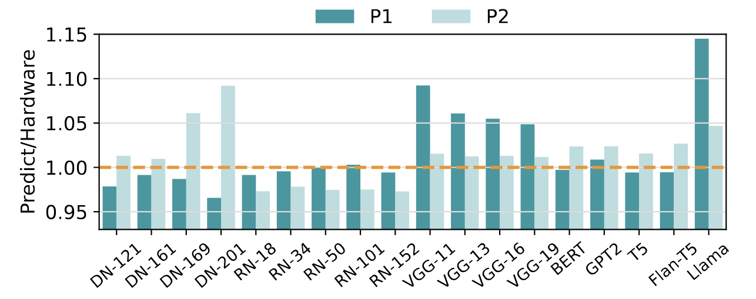
Experiment
Data parallelism
Prediction errors comparing using TrioSim with applying distributed data parallelism on P1 and P2.
The average errors of the experiment set for P1 and P2 are 2.91% and 2.73%.

Slide 32
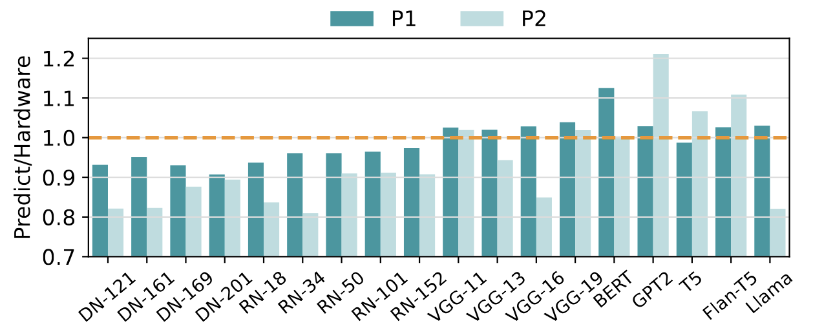
Experiment
Tensor parallelism
Prediction errors comparing using TrioSim with applying Tensor parallelism on P1 and P2.
The average errors of the experiment set for P1 and P2 are 4.51% and 11.24%.

Slide 33
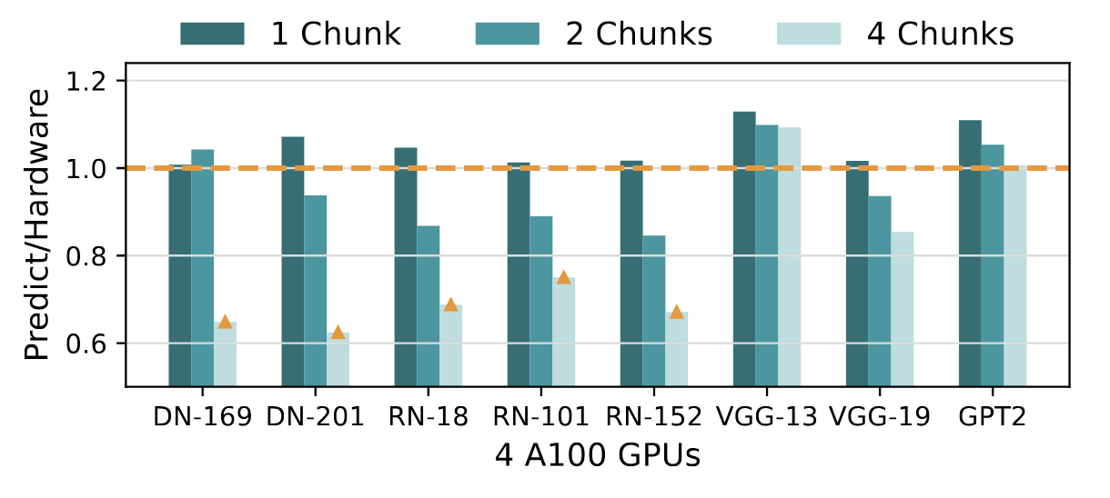
Experiment
Pipeline parallelism
The prediction error comparing using TrioSim with applying pipeline parallelism on 4 A100 GPUs.
The average errors are 5.14%, 8.96%, and 8.18% for 1 chunk, 2 chunks, and 4 chunks, respectively.

Slide 34
Experiment
New GPUs validation-----validate on P3, 8 H100 systems
Case 1 (cross-GPU prediction), input (1xA40 & 1xA100, BS128), output (8xH100, BS256);
traces from single A40 and A100 GPUs with a batch size of 128—
following Li’s model—to predict the performance on the 8 H100 system at batch size 256.
Case 2 (same-GPU prediction), input (1xH100, BS256), output (8xH100, BS256)
traces for a batch size of 256 on a single H100 GPU and use it as input of TrioSim to predict performance for the 8 H100 system.

Slide 35
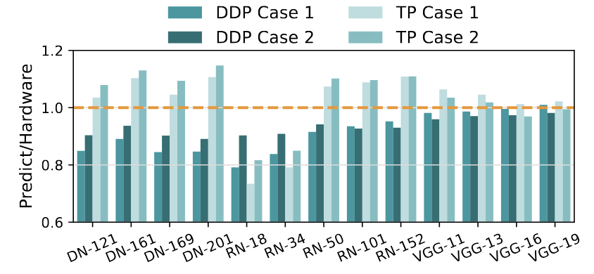
Experiment
New GPUs validation-----validate on P3, 8 H100 systems
Case 1 (cross-GPU prediction),
the average error is 9.09% for data parallelism, 9.07% for tensor parallelism
Case 2 (same-GPU prediction),
the average error is 6.69% for data parallelism, 9.09% for tensor parallelism

Slide 36
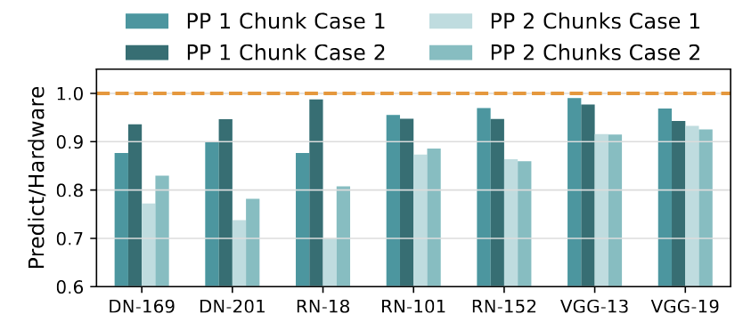
Experiment
New GPUs validation-----validate on P3, 8 H100 systems
Case 1 (cross-GPU prediction),
the average error is 5.65%, 16.28% for pipeline parallelism with 1, and 2 chunks, respectively.
Case 2 (same-GPU prediction),
the average error is 4.20%, 13.76% for pipeline parallelism with 1, and 2 chunks, respectively.

Slide 37
Use Cases
explore multi-GPU systems.
study high-level system behaviors,
e.g. parallelization strategies, network topologies, and scaling configurations.
combined with low-level simulators for architecture-level investigations.

Slide 38
Limitations
Cannot evaluate fine-grained hardware modifications directly.
Accuracy drops when low GPU utilization limited by Li’s linear regression-based model.
Overlooks protocol-level and low-level communication effects.
Validation limited to CNNs and Transformers.

Slide 39
Summary
TrioSim Lightweight
Flexible
Accurate

Slide 40

TrioSim
Thank you!
Ying Li
Ph.D. Candidate
https://yingliphd.com
Scalable Architecture Lab

Slide 41
Backup Slides

Slide 42
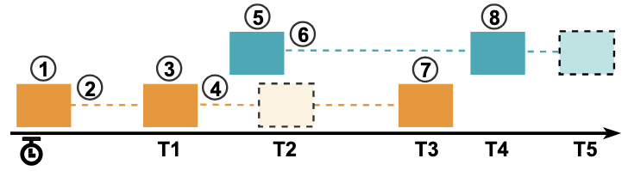
TrioSim
Case A: only one message in the link.
A new message comes.
Routing, bandwidth allocation, and scheduling an event at the time, T1.
3) No new message comes, the destination device receives the message at the time, T1.

Slide 43
TrioSim
Case B: two messages in the link.
4) Send the message to the destination. Routing, bandwidth allocation, and scheduling events at the time, T2.
5) A new message starts to transfer, and the current two messages share at least one link.
6) Recalculate the bandwidth and reschedule the delivery events of all the packets that are currently in transit at the time, T3 and T5 separately.
7) The destination receives the orange message at the time, T3. Because the orange message is received,
it recalculates the bandwidth and reschedules the delivery event for the blue message at the earlier time, T4.
8) The destination receives the message at the time, T4.

Slide 44
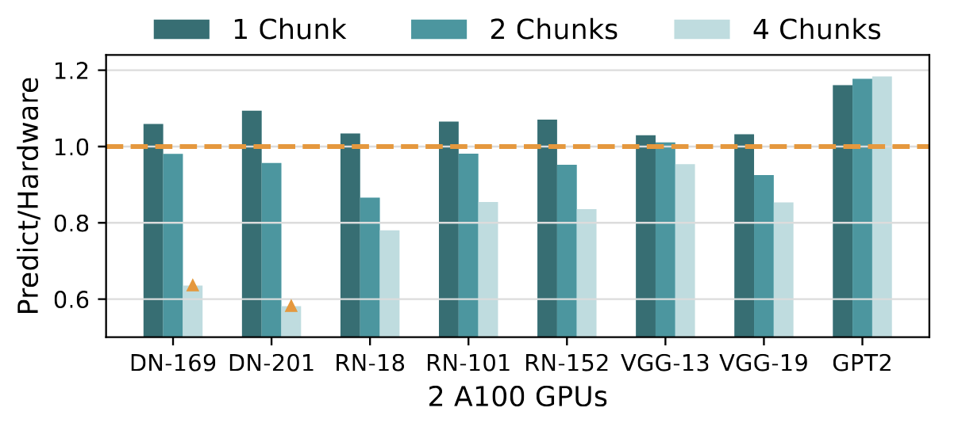
Experiment
Pipeline parallelism
The prediction error comparing using TrioSim with applying pipeline parallelism on 2 A100 GPUs .
The average errors are 6.82%, 6.58%, and 15.10% for 1 chunk, 2chunks, and 4 chunks, respectively.
Orange triangle: an abnormal value contrary to the theoretical expectation that execution times should decrease with more chunks.

Slide 45
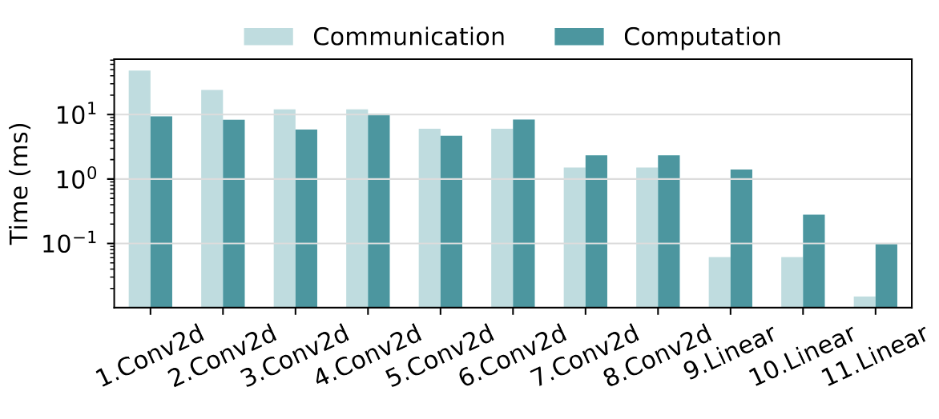
Experiment
Communication & computation time
Communication and computation times for all the ATen layers of Convolution and Linear operations during the forward stage of VGG-11 training by tensor parallelism on P1.

Slide 46
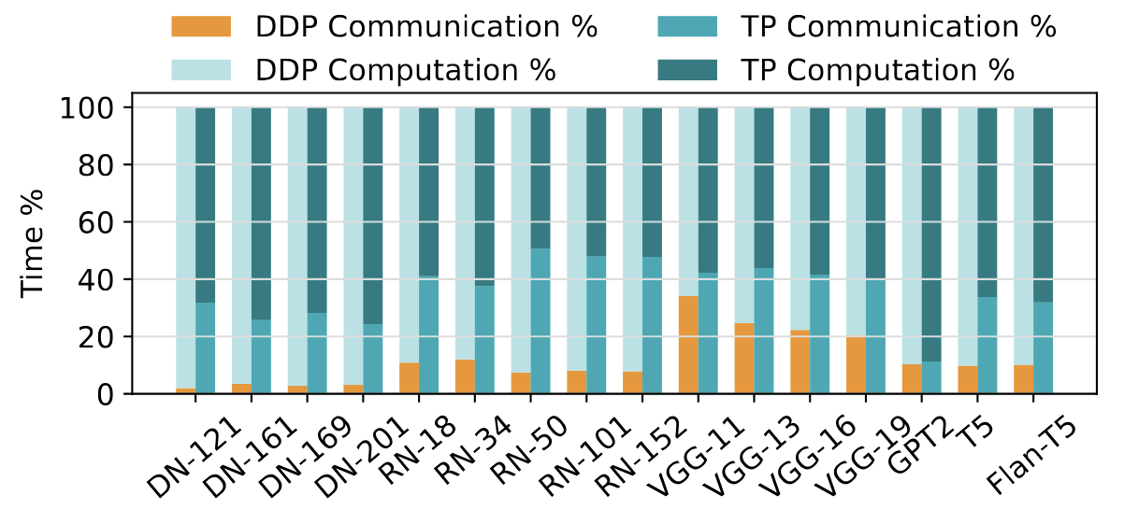
Experiment
Communication & computation time
Communication and computation time ratio for models training with tensor parallelism and data parallelism simulations on P1.

